Slide 1


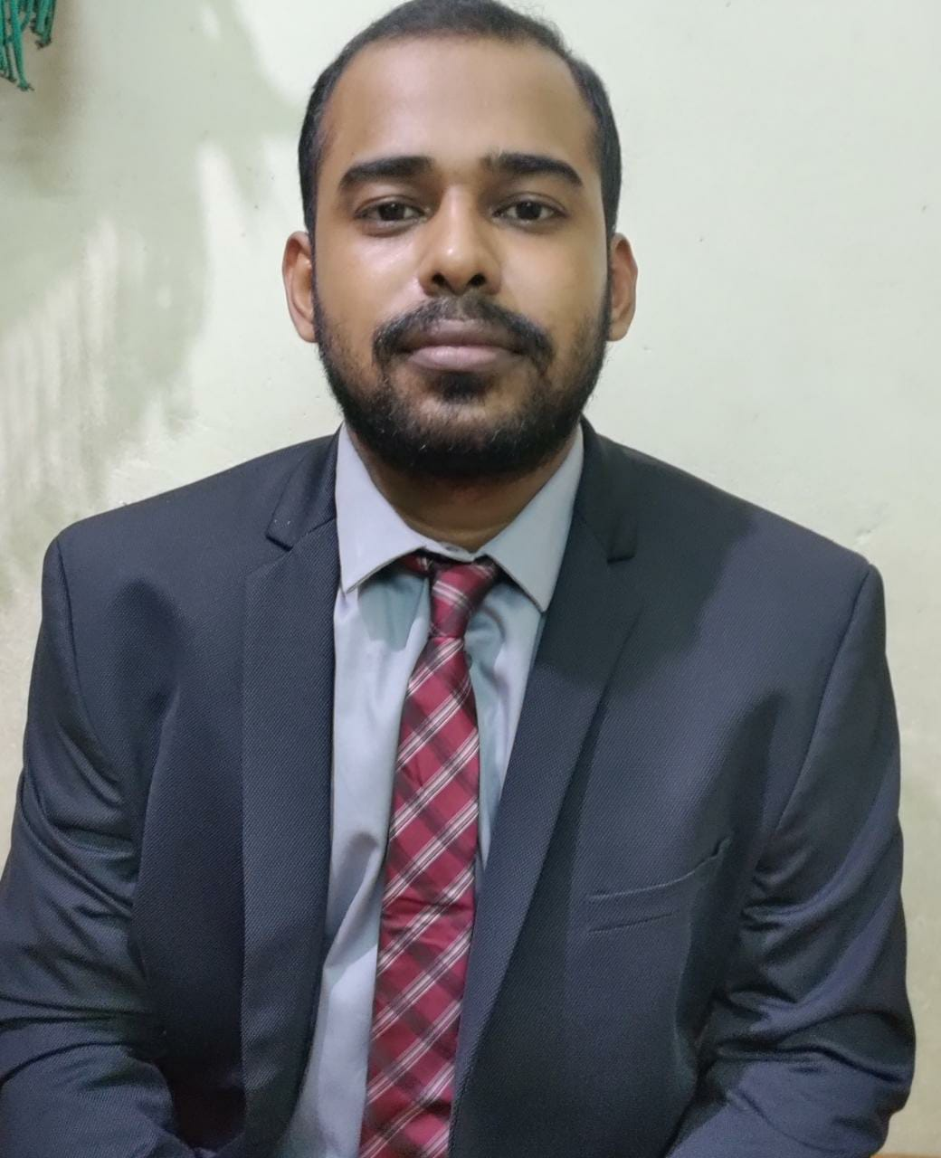
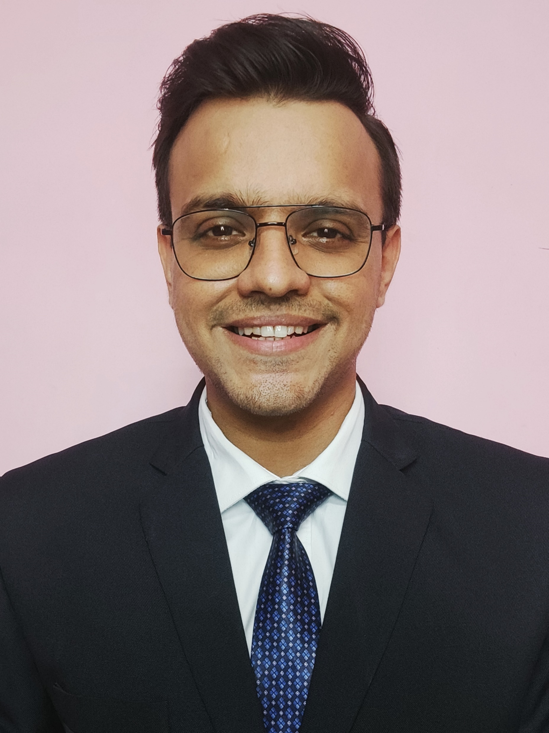
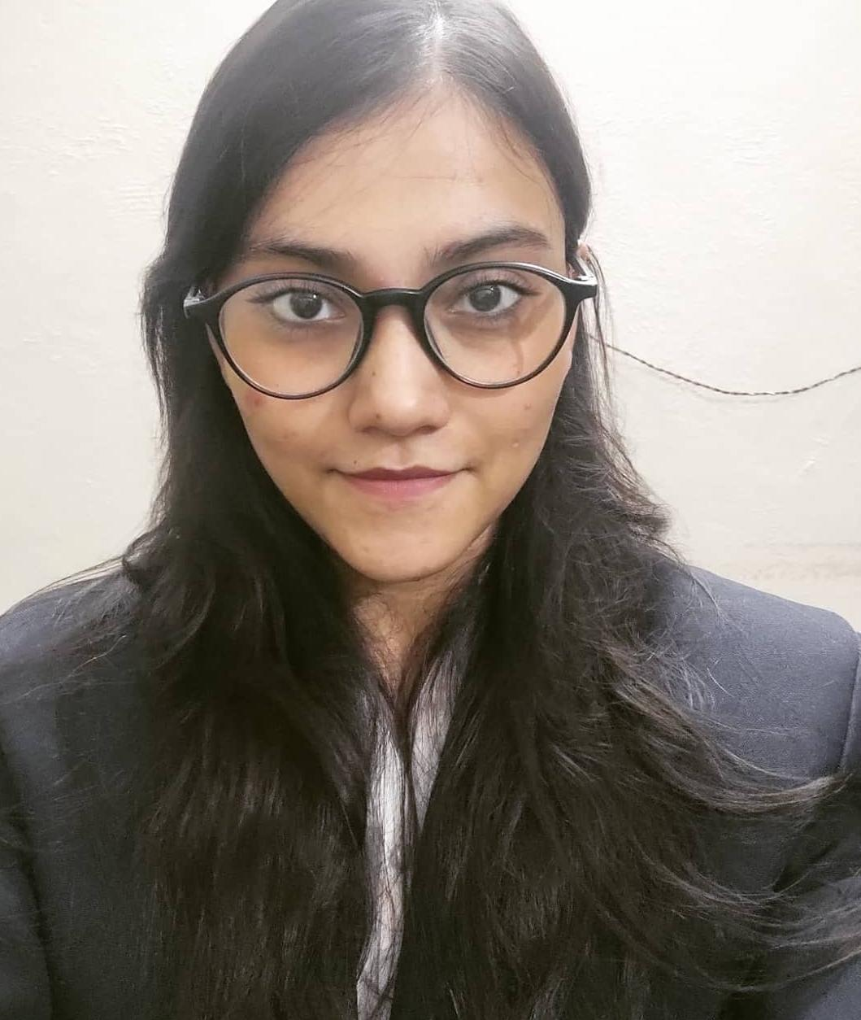
Team SORTED
Devesh Sinha Mohit Kiradoo Kajal Gupta
T. A. Pai Management Institute

Slide 2
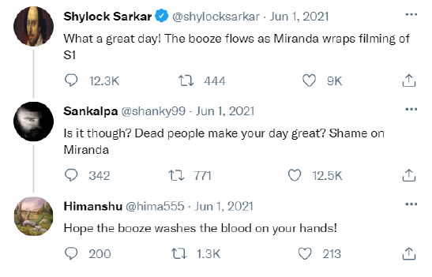

Ye kya hua? Kaise hua? Kab hua? Kyun hua?
Fire Fighting PR Strategy
Workaround and Timeline
Oh! the timing, June 2021
Court Kachery, October 2022
Problems knocking the door
Lawsuit against the book
Public sympathy for Aftab Ahmed increased
Tweet war between the both got initiated
Trailer release of The Last Men and announcement of the premiere date on NetFilms
FSSAMU, October 2022
Loss of Ad Revenue if premiere is delayed
Cost cutting, August 2022
The Film Studios Setting & Allied Mazdoor Union (FSSAMU) claimed that Miranda Studios continued to employ workers but have not paid them wages since May 2019.
Incidentally, on the same day, Shylock posted a tweet, 'An artist with a hungry stomach creates better art!’
Some of the stars who featured in the TV series filed legal suits against Miranda Studios over non-payment of dues and refused to renew their contract with them.
BOYCOTT Trend started
Miranda Studios terminated the
contracts of 12 web series offered to independent artists and directors, immediately creating an uproar in the film workers' community.
NetFilms downloads are the lowest, Media partners are pulling out, Talents are poached, and they are ready to leave
Book Release, October 2022
Labor unions at the throat and media ready to suck blood
Aftab Ahmed released his book which took Miranda Studios and Shylock in bad light
Book’s snippets were trending on twitter
Celebs joined the #meetoo
Defense by Shylock
Lawsuits are on the verge of loss, public perception is already negative

Slide 3
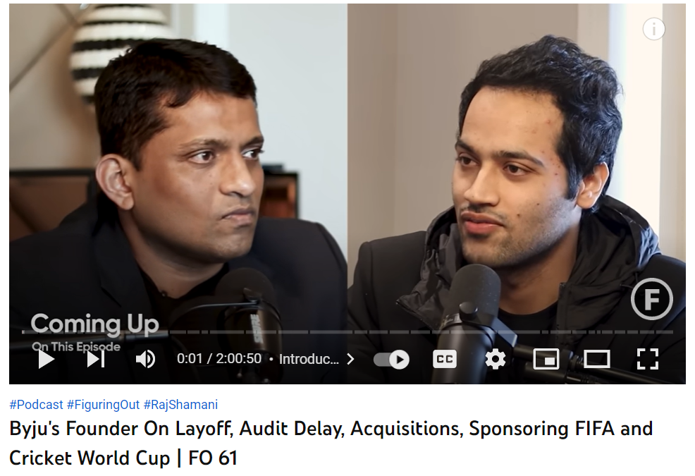
Ye kya hua? Kaise hua? Kab hua? Kyun hua?
Fire Fighting PR Strategy
Workaround and Timeline
Strategy Objective: Stop the spread of negative news on social media by changing the narrative
Strategic Steps
External Stakeholders: Audience, NetFilms users, Artists, Agencies and Critics
Internal Stakeholders: Investors, Employees, Shylock Sarkar and others
Dos | Don’ts
Testimonial videos of superstars who got their first break through Miranda Studios | Celebrating any success
Rigorous advertisements of the successful and loved movies of Miranda Studios and Shylock Sarkar | Overdo social media posts and other PR stunts. It will look obvious
Financial settlement to the unpaid artists during COVID and 3rd party press release for same | Stating anything in the press of social media about the legal issues
Trailer release of THE LAST MEN | Controversial stand on any topic related Aftab Ahmed
Dos | Don’ts
Shylock Sarkar to be refrained from using Twitter for a while and remain underground on social media | Let the existing artists, employees and other related members leave (Otherwise they’ll join hands with the detractors
10 Days Diwali holidays to the employees of Miranda Studios and NetFilms for mental health and family time. Diwali incentives to all the full-time employees
Some Whitewashing on Famous Podcasts
Podcast Content
How did Miranda Studious start
Theatre days of Shylock
What he learnt from successes and failures
How Miranda House became low key to mainstream
Recent controversy with Aftab Ahmed (Where he will say that it all happened due to miscommunication and he Miranda needs Aftab)
How he deal with hatred on social media (Modest answer “Fans are god” types
An exclusive conversation (casual interview of Shylock Sarkar by famous YouTube Podcasters (Ex – Raj Shamani or Samdhish Bhatia about his life, career and other stuffs
Reference:

Slide 4
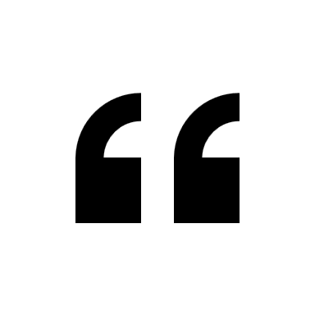
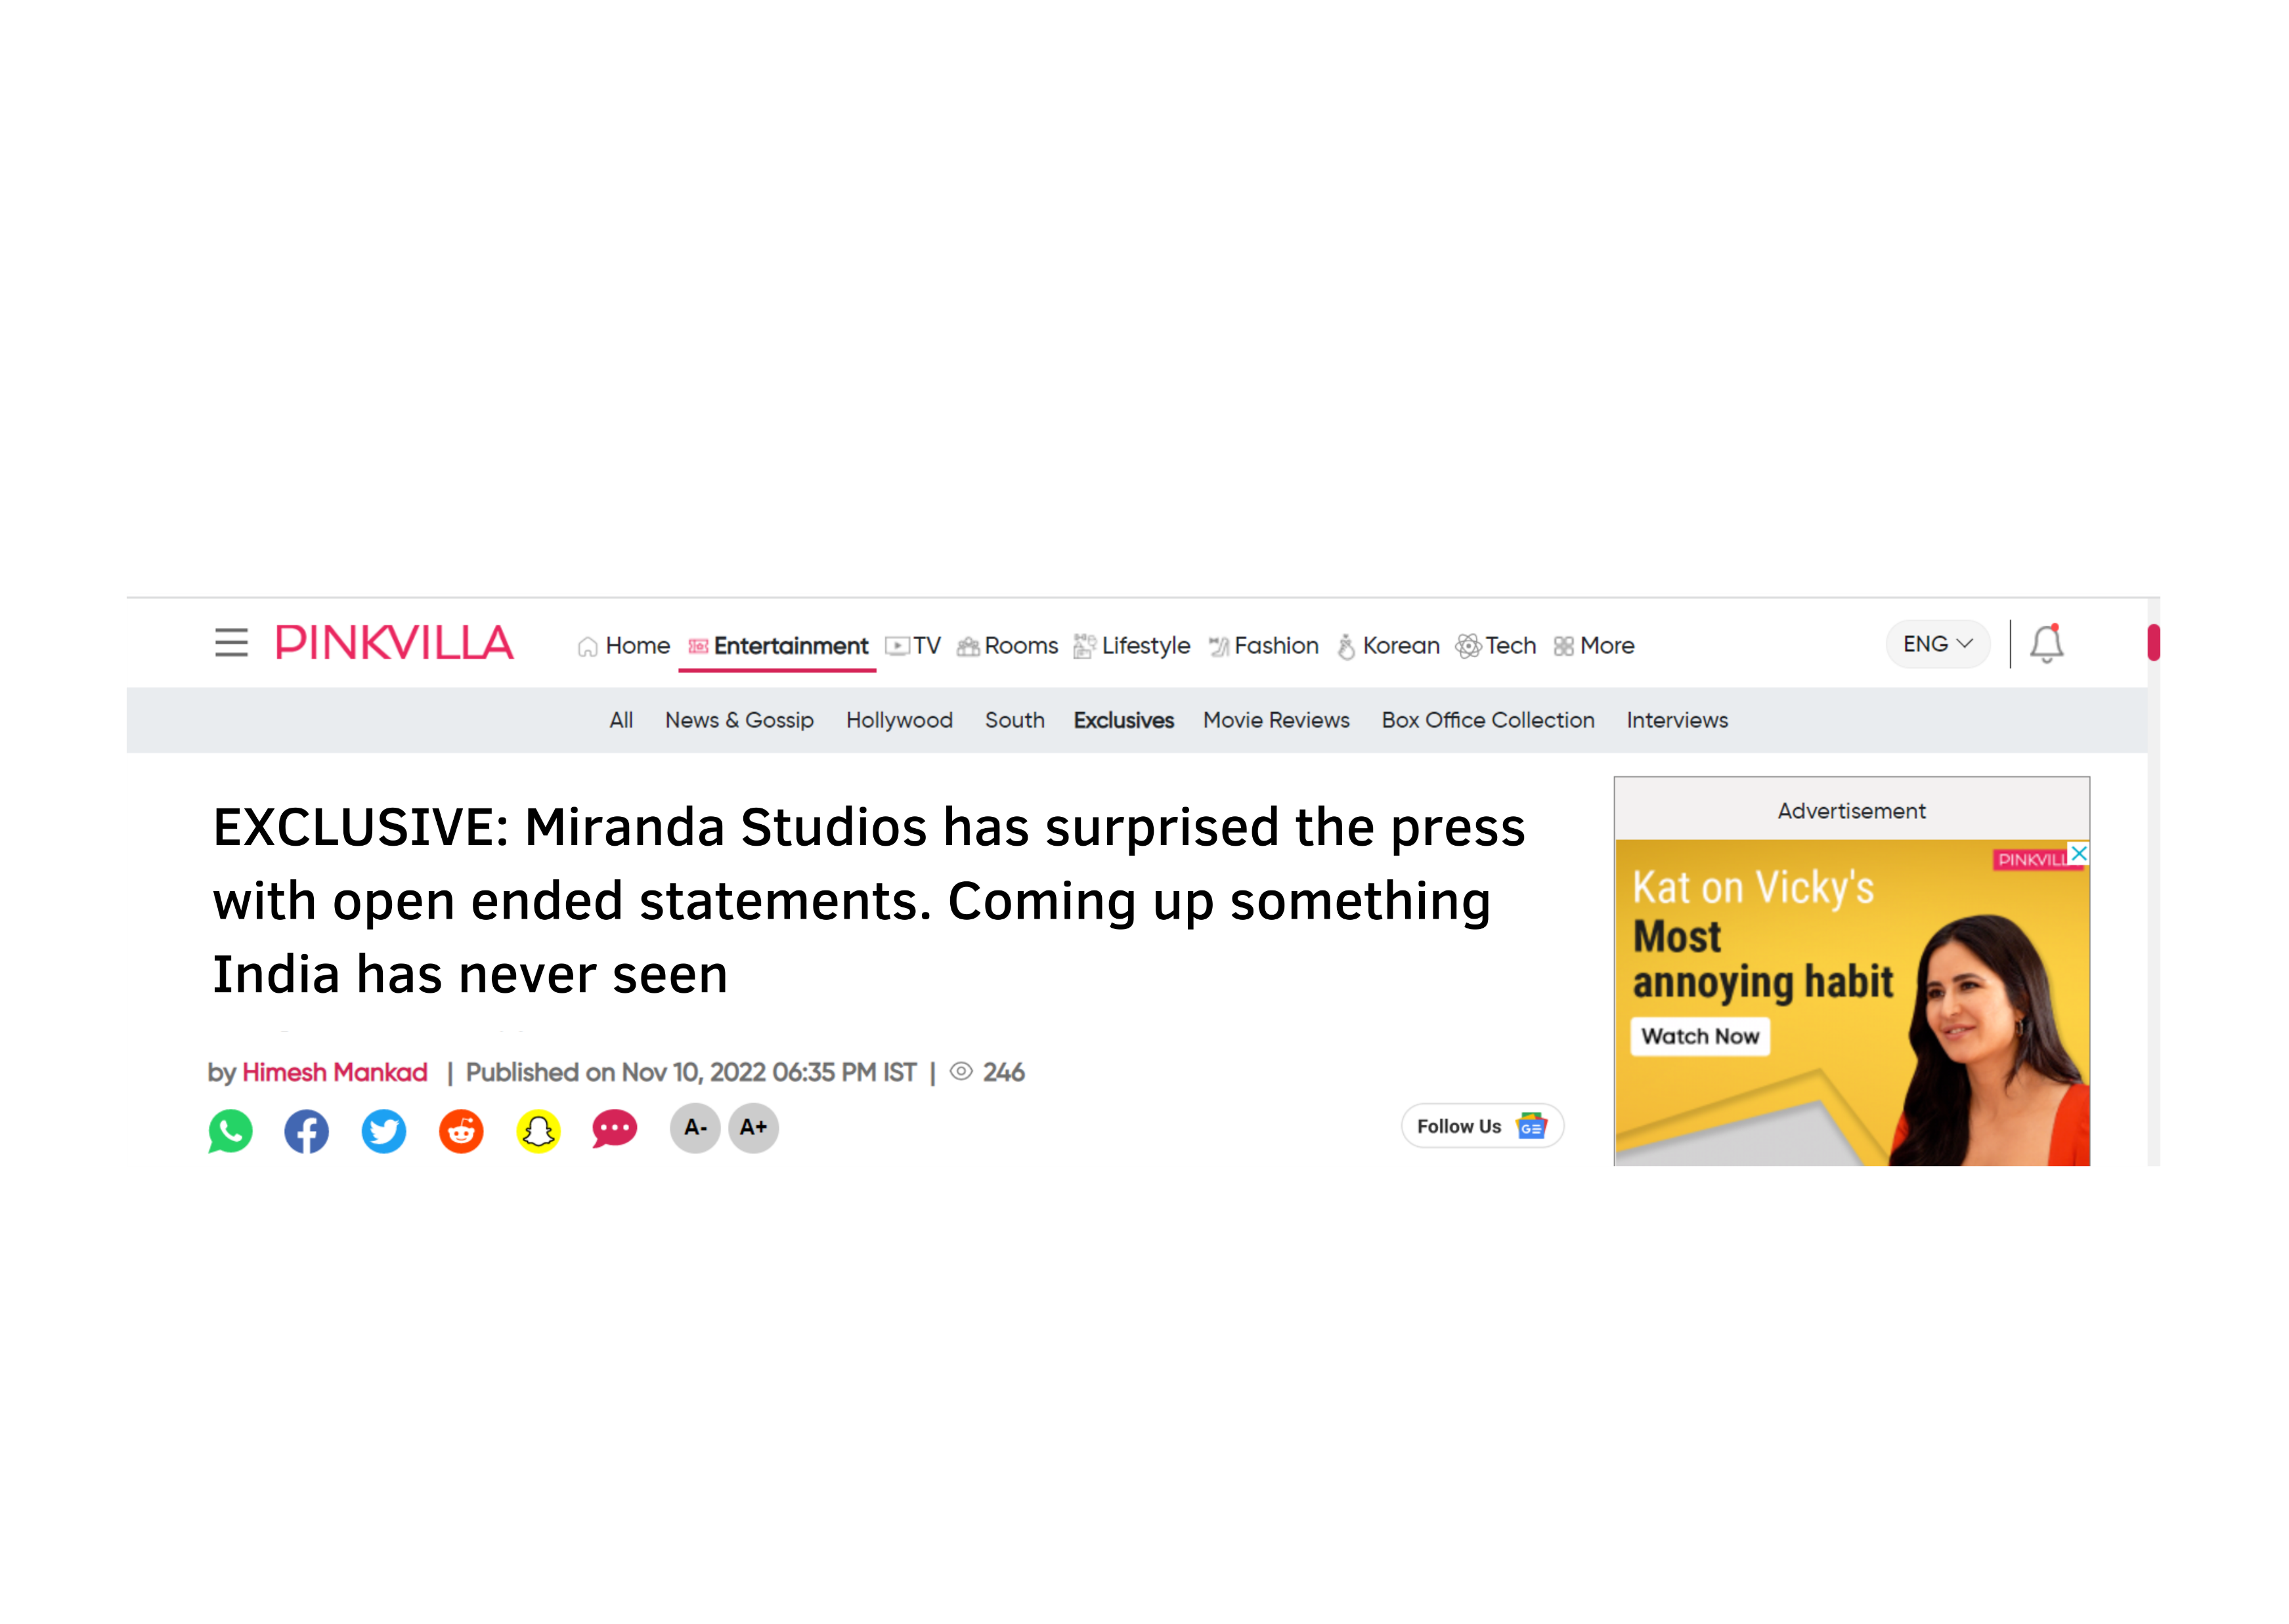
Ye kya hua? Kaise hua? Kab hua? Kyun hua?
Fire Fighting PR Strategy
Workaround and Timeline
Tomorrow morning press conference statement
The entire staff of the Miranda studios is geared up for a new trek. We felt honoured that people are with us through thick and thin and they believe in the art we have created so far. We promise not to disappoint them with something that India has never seen before soon. The journey was exciting!, hold on your horses!
Owned + Shared
Earned + Paid
Owned + Shared
Expected reaction
Owned + Shared
Owned + Shared
2022
2023
October | Nov | Jan | Feb | Mar | Apr | May | June | July | August | Sep | October
PODCAST and its promotion
Paid ads
Videos
Paid ads
Videos
Paid ads
Videos
Trailer release and premiere announcement
Settlement of legal issues and its PR
Pending payments and its PR
Premier release on 1st September and its promotions
Diwali Holidays to employees and new year incentives
Release & promotion of Arijit Singh’s song from the series on reels and FB
Narrative change strategies

